Slide 1


Decision-Action Decoupling: Mechanisms and Neural Bases
Thesis committee Monitoring 2024
Johan Achard
Supervised by Mathieu Servant and Thibault Gajdos
Notes:
For the next 20 minutes, I present you our research work in my thesis, which name “Decision-action decoupling: mechanisms and neural basis”

Slide 2
Highlights
Manuscript in revision in JEP: General (Extending continuous flow models of immediate decision reports to delayed decision reports, work presented last year)
Presentation of this work (poster) at the Psychonomics Society Conference 2023 (San Francisco)
Model-Based Neuroscience and Cognition Summer School, 2024, Amsterdam
112 hours of teaching (Statistics and experimental methods 72h, Cognitive processes 24h, Student professionalization 16h)

Slide 3
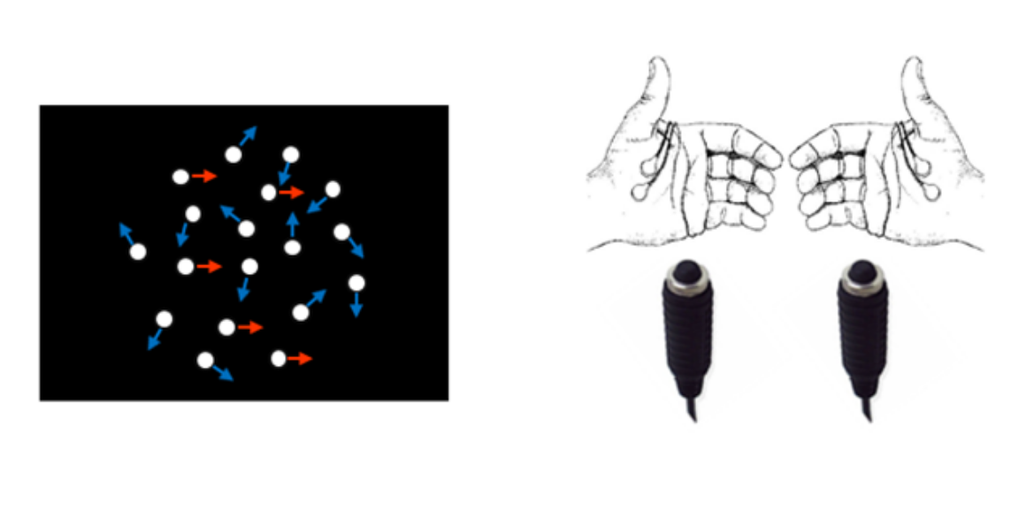
We want separate the choice from the corresponding action.
To this end, we have used a response signal variant of the random dot motion task, in which we added a delay (3 to 7s) between the presentation of stimulus and the response signal.
Stimulus
Delay
Response Signal
RS

Slide 4
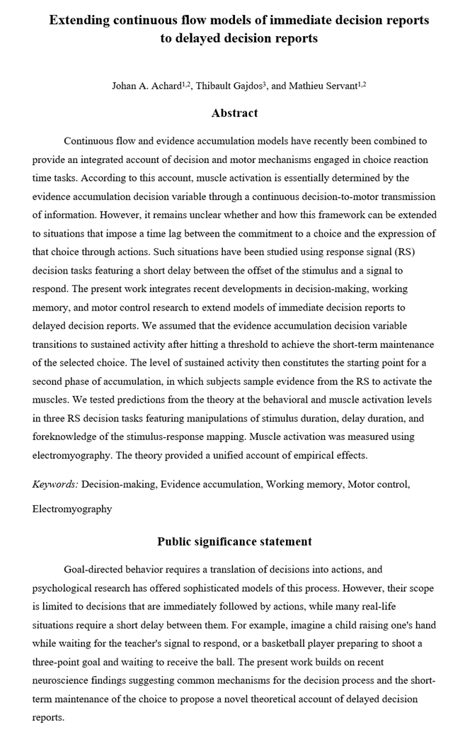
Past research
We proposed an extension of the Gated Cascade Diffusion Model (GCDM, Dendauw et al., 2024, Psy Rev) for response signal tasks based on behavioral and neurophysiological findings in both monkeys and humans.
We tested general predictions from the model using behavioral and EMG data in three response signal experiments, in which we manipulated various variables (stimulus presentation duration, delay duration, and foreknowledge of stimulus-response mapping).
The data are generally consistent with model predictions.
Notes:
Importantly, ramping effector-selective motor preparation signals appear to plateau during the delay period before the RS (de Lafuente et al., 2015; de Lange et al., 2013; Donner et al., 2009; Horwitz & Newsome, 1999; Kiani et al., 2008; Rao et al., 2012; Rogge et al., 2022; Roitman & Shadlen, 2002; Shadlen & Newsome, 2001; Twomey et al., 2016).

Slide 5
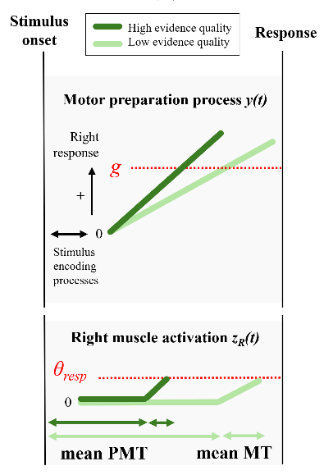
Reminder: architecture of the Gated Cascade Diffusion Model (GCDM) for immediate decision reports
Continuous transmission of the decision variable to the motor structures that prepare the response.
The decision variable is corrupted by biological noise during the transmission process.
The motor preparation system attempts to deduce the decision state using an approximate Kalman-Bucy filter.
The resulting motor preparation variable is subjected to gating inhibition before reaching muscle fibers.
The neural drive to muscle fibers thus reflects the motor preparation variable when it exceeds gating inhibition.
The response (button press) is issued when the neural drive reaches a criterion level of activation (response threshold).
Dendauw et al., 2024, Psy Rev

Slide 6
Extension of GCDM to delayed decision reports (response signal tasks)
Due to time constrains, I will focus on a response signal task in which (1) participants know the S-R mapping during stimulus presentation, (2) the delay is fixed to 3s, and (3) motion coherence (2, 11, 40 corresponding to low, medium and high difficulty levels) and stimulus duration (0.3, 1, 2s) are manipulated and randomized within blocks of trials.
Notes:
Thresshol plateu
Mixture termine no termidet

Slide 7

Extension of GCDM to delayed decision reports (response signal tasks)
Stimulus duration and coherence
2s
High coherence
300 ms
Low coherence
During stimulus presentation, the decision variable is continuously transmitted to motor preparation brain areas (similar to immediate decision reports), but the level of gating inhibition increases to prevent muscle activation.
Stimulus onset
Stimulus offset
RS
Response
g
$θ$resp
PMT 2s
PMT 300ms
MT

Slide 8
Extension of GCDM to delayed decision reports (response signal tasks)
Stimulus duration and coherence
2s
High coherence
300 ms
Low coherence
During stimulus presentation, the decision variable is continuously transmitted to motor preparation brain areas (similar to immediate decision reports), but the level of gating inhibition increases to prevent muscle activation.
During the delay, the motor preparation variable transitions to sustained activity after hitting a threshold to achieve the short-term maintenance of the selected choice.
The average level of sustained activity decreases as stimulus duration decreases, due a mixture of terminated and non-terminated processes (Ratcliff, 2006).
For the same reason, the average level of sustained activity also decreases as the quality of sensory evidence decreases. A short post-threshold accumulation period (Mazurek et al., 2003) or a threshold that decreases as processing time increases (Drugowitsch et al., 2012) may also contribute to this phenomenon.
Stimulus onset
Stimulus offset
RS
Response
g
$θ$resp
PMT 2s
PMT 300ms
MT

Slide 9
Extension of GCDM to delayed decision reports (response signal tasks)
Stimulus duration and coherence
2s
High coherence
300 ms
Low coherence
During stimulus presentation, the decision variable is continuously transmitted to motor preparation brain areas (similar to immediate decision reports), but the level of gating inhibition increases to prevent muscle activation.
During the delay, the motor preparation variable transitions to sustained activity after hitting a threshold to achieve the short-term maintenance of the selected choice.
The average level of sustained activity decreases as stimulus duration decreases, due a mixture of terminated and non-terminated processes (Ratcliff, 2006).
For the same reason, the average level of sustained activity also decreases as the quality of sensory evidence decreases. A short post-threshold accumulation period (Mazurek et al., 2003) or a threshold that decreases as processing time increases (Drugowitsch et al., 2012) may also contribute to this phenomenon.
When the RS is presented, the level of sustained activity constitutes the starting point for a second phase of accumulation, in which subjects sample evidence from the RS to activate the muscles (similar to models of one-choice response time tasks; Ratcliff & Van Dongen, 2011).
Stimulus onset
Stimulus offset
RS
Response
Motor preparation
g
Neural drive to muscle fibers (EMG)
$θ$resp
PMT 2s
PMT 300ms
MT

Slide 10
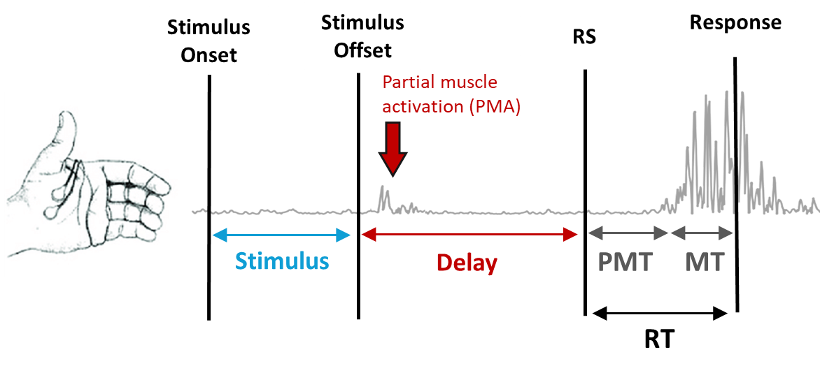
Model predictions
The primary measures of interest were:
Response accuracy,
The rate of Partial Muscle Activation (PMA) during the delay, i.e., the number of PMA per second,
Premotor time (PMT: latency between RS and the onset of muscle activation),
The slope of muscle activation
Motor time (MT: latency between the onset of muscle activation and the response)
Notes:
. The rate of partial muscle activation in the EMG channel associated with the response clearly increased over the three periods. This phenomenon is fully consistent with GCD_{RS}: gating inhibition is assumed to be at a similar level during stimulus presentation and the delay, but the motor preparation variable is at a lower level on average during stimulus presentation. After the RS, the motor preparation variable increases again (and gating inhibition possibly decreases). Thus, the probability of the motor preparation variable to overcome gating inhibition due to noise at the single-trial level increases over the three periods, consistent with observed data.

Slide 11
Model predictions
A reduction in stimulus duration should increase the proportion of trials in which trajectories motor preparation do not reach the internal threshold.
Consequently, the average level of sustained activity at the motor preparation level during the delay should decrease as stimulus duration decreases, leading to three predictions:

Slide 12


Model predictions
A reduction in stimulus duration should increase the proportion of trials in which trajectories motor preparation do not reach the internal threshold.
Consequently, the average level of sustained activity at the motor preparation level during the delay should decrease as stimulus duration decreases, leading to three predictions:
  Accuracy should decrease as stimulus duration decreases at the intermediate coherence level (due to floor and ceiling effects).

Slide 13
Model predictions
A reduction in stimulus duration should increase the proportion of trials in which trajectories motor preparation do not reach the internal threshold.
Consequently, the average level of sustained activity at the motor preparation level during the delay should decrease as stimulus duration decreases, leading to three predictions:
  Accuracy should decrease as stimulus duration decreases at the intermediate coherence level (due to floor and ceiling effects).
  Mean PMT should increase as stimulus duration decreases, because the starting point for the second phase of evidence accumulation is located father away from the gate on average. For the same reason, mean PMT should decrease when coherence increases.

Slide 14
Model predictions
A reduction in stimulus duration should increase the proportion of trials in which trajectories motor preparation do not reach the internal threshold.
Consequently, the average level of sustained activity at the motor preparation level during the delay should decrease as stimulus duration decreases, leading to three predictions:
  Accuracy should decrease as stimulus duration decreases at the intermediate coherence level (due to floor and ceiling effects).
  Mean PMT should increase as stimulus duration decreases, because the starting point for the second phase of evidence accumulation is located father away from the gate on average. For the same reason, mean PMT should decrease when coherence increases.
  The rate of Partial Muscle Activation (PMA) in the EMG channel associated with the response during the delay should increase as stimulus duration increases. It should also increase as motion coherence increases.
Notes:
Solid lines
Dotted lines

Slide 15
Model Predictions
4. The mean MT and the slope of muscle activation should not be modulated by coherence and stimulus duration, because the activation of the muscle leading to the response is driven by evidence sampled from the RS.
Empirical results showed that the slope of muscle activation decreased as motion coherence decreased, but the amplitude of this effect was too small to produce a reliable modulation of mean MT.
These findings suggest that the rate of evidence accumulation in phase 2 is determined by two sources of evidence:
  Evidence sampled from the RS
  Evidence from the motion stimulus retrieved from memory (to a much lesser extent)

Slide 16
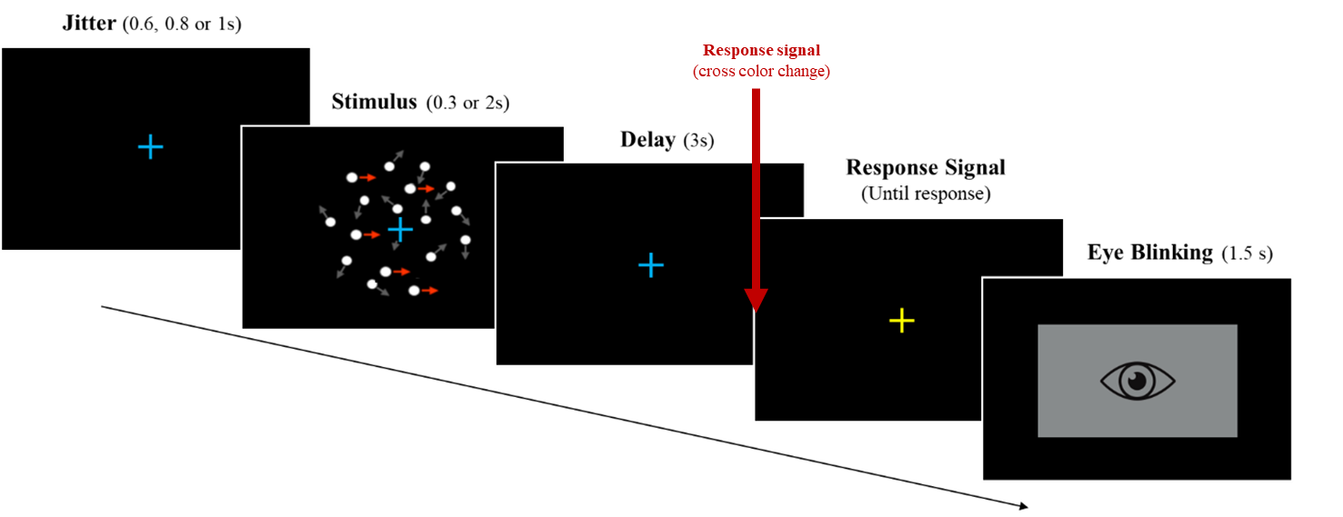
Current research
We have conducted a similar experiment combining EMG and EEG with 2 levels of stimulus duration (300ms vs 2s) and 3 coherence levels (0%, 12%, 50%). The delay was fixed to 3s. (21 subjects: 5 men; mean age = 20.08, range 18-24)
In this experiment, the response signal was the change in the color of the fixation cross (from blue to yellow).
  960 trials (160/condition)
  Goal of the experiment:
  Test model predictions at the motor preparation level.
  We hypothesized that activity in the mu-beta band over the motor cortex (but not the LRP) should reflect model dynamics (Rogge et al., 2022, Neuroimage).

Slide 17
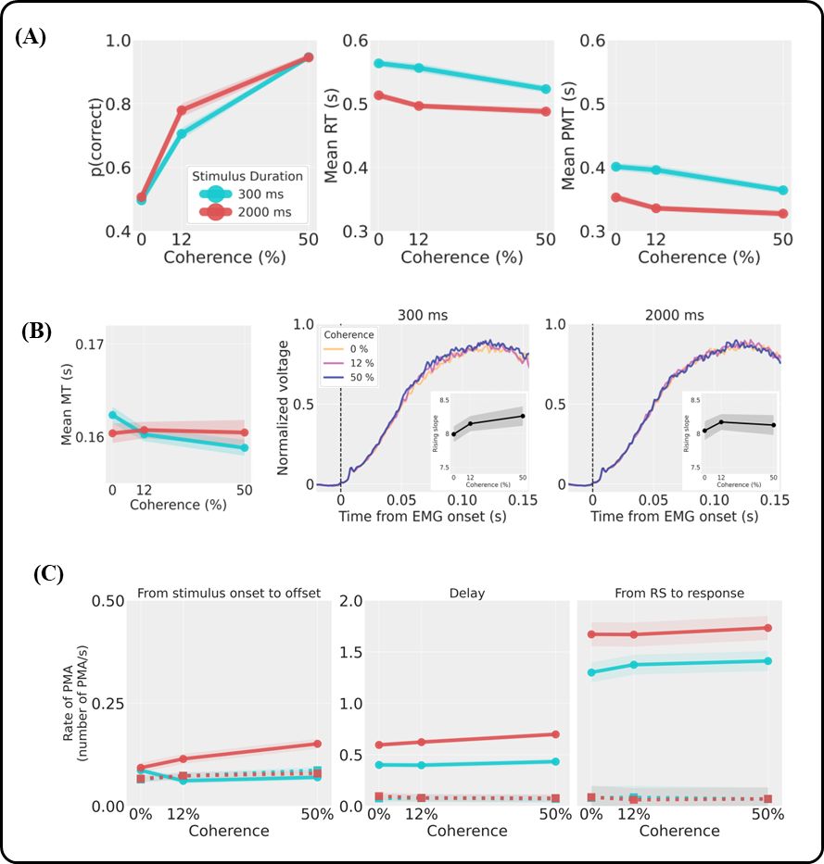
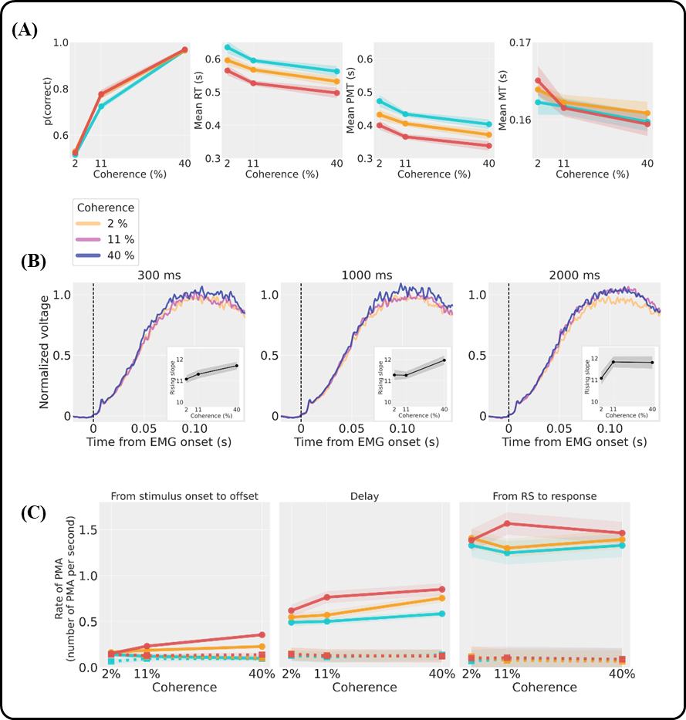
EMG and behavioral results
We found similar behavioral and EMG results, with the exception that the EMG slopes were not significantly modulated by motion coherence.
Current EEG + EMG experiment
Previous similar EMG experiment

Slide 18
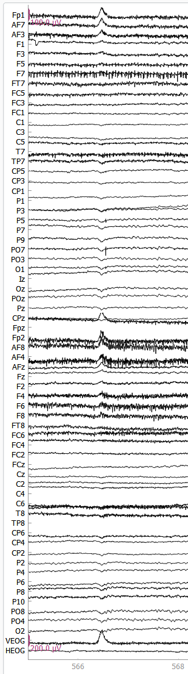
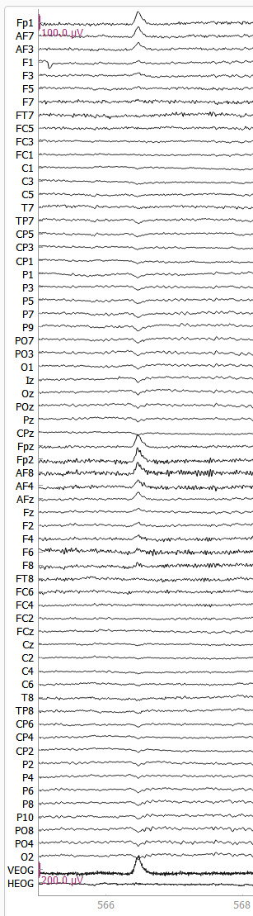
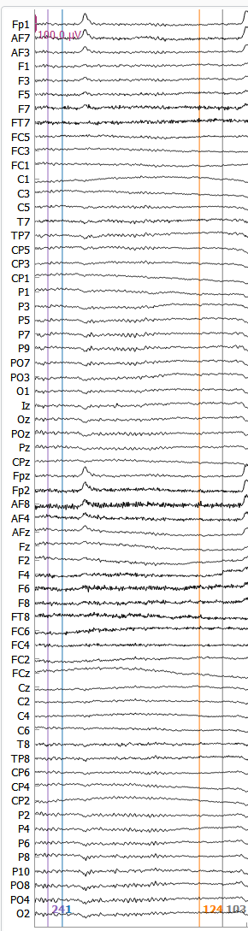
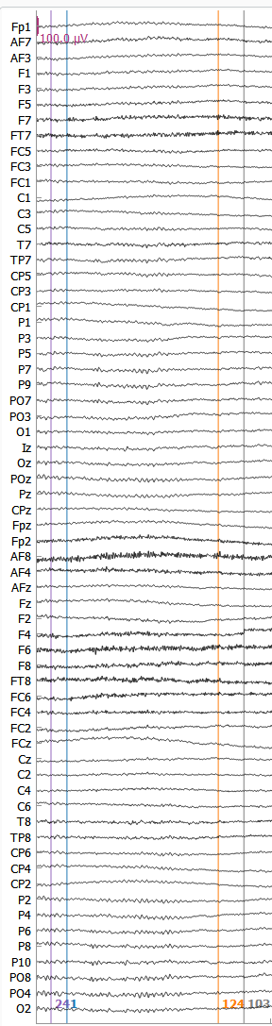
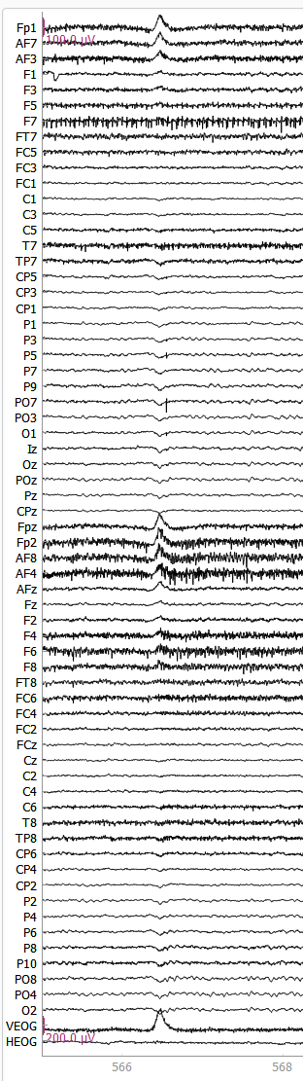
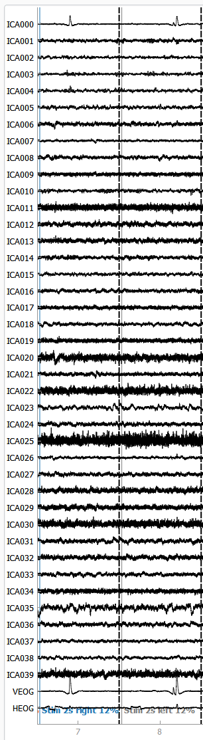


EEG Preprocessing: ICA to remove eye movement artifacts
64 eeg channels, Biosemi system
Raw signal
Filter signal (0.1 - 40Hz)
Apply ICA on Epochs
Epoch No ICA
(0.1 - 40Hz filter)
Epoch ICA
(0.1 - 40Hz filter)
Filter signal 1 Hz and compute ICA on epoch
Select ICs components
of interest
Before ICA :
57.7% valid trials
After ICA :
92.6% valid trials
Notes:
MNE pytg

Slide 19
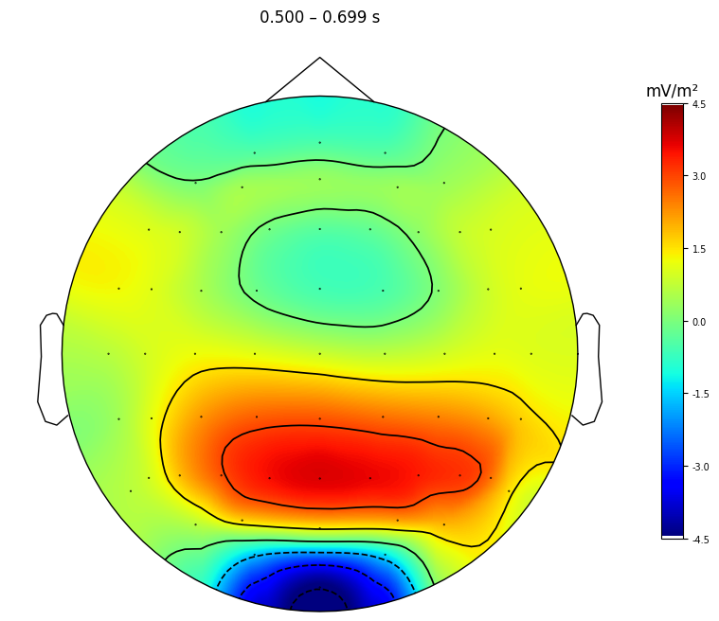
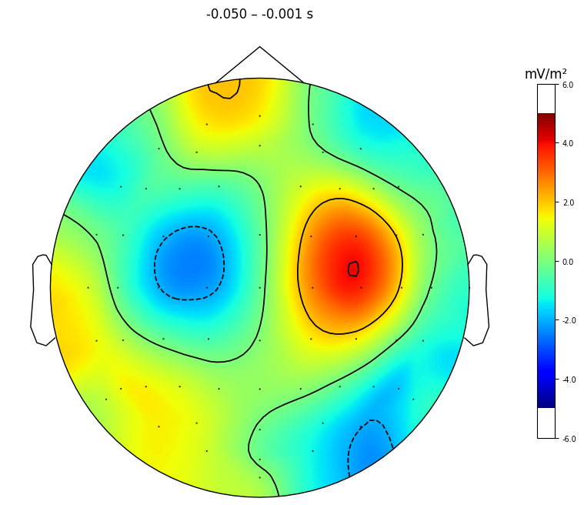
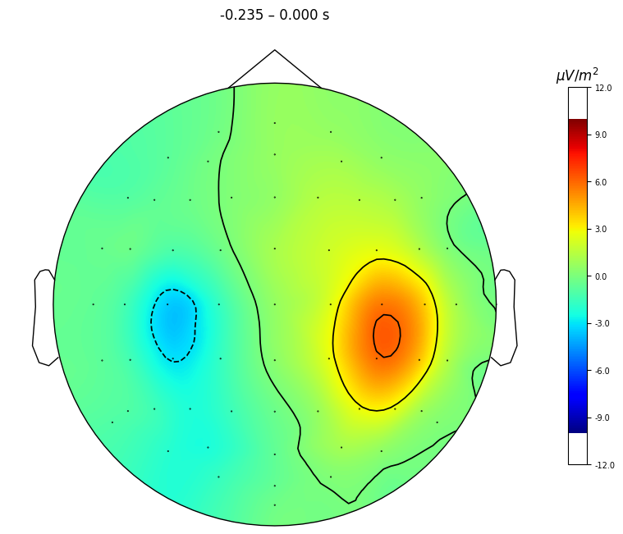
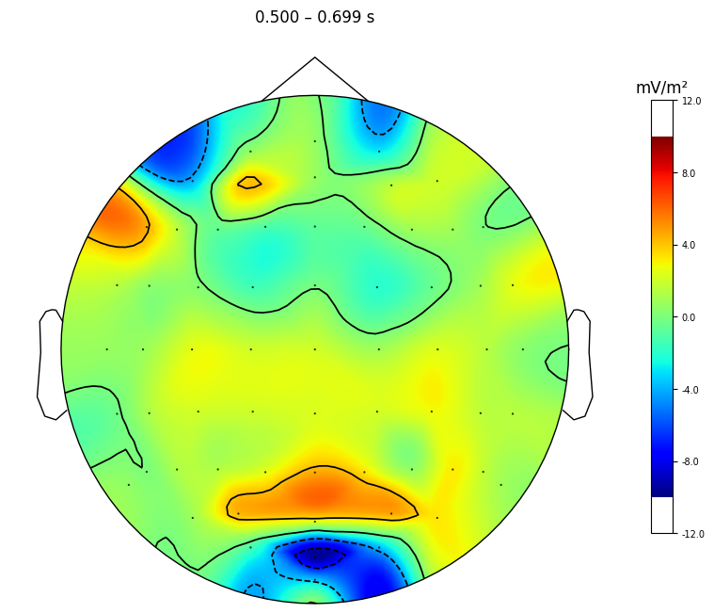
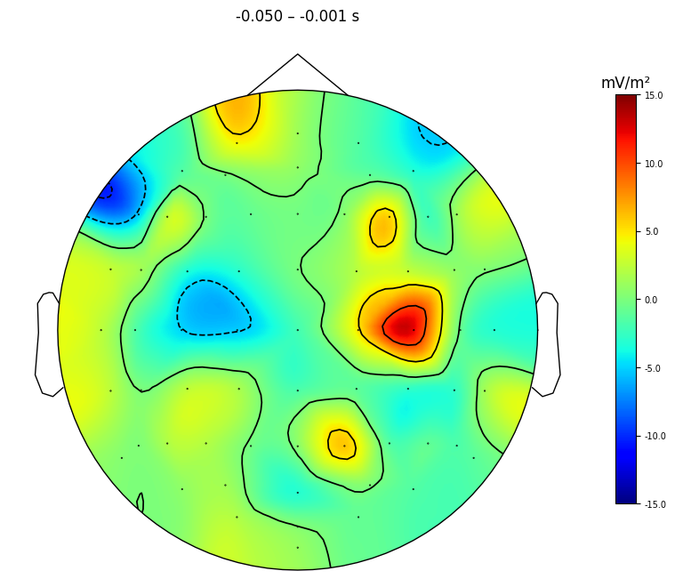
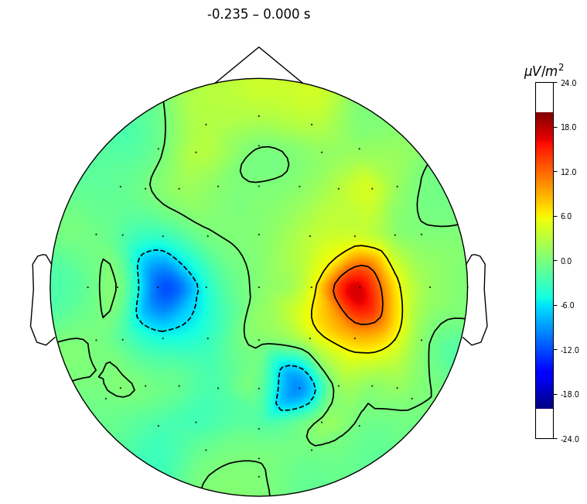
EEG Preprocessing: Current source density (CSD)
Electrodes used for analyses:
C3/C4 for Mu-beta and LRP
Pz for CPP
Stimulus time-locked
Response time-locked
Stiffness = 4
(default)
The stiffness parameter of the CSD increases the spatial resolution, but also increases noise.
CPP
LRP: right press – left press
Mu-beta (STFT, window 600 ms)
Stiffness = 3
(spatial resolution increases,
but more noisy)

Slide 20
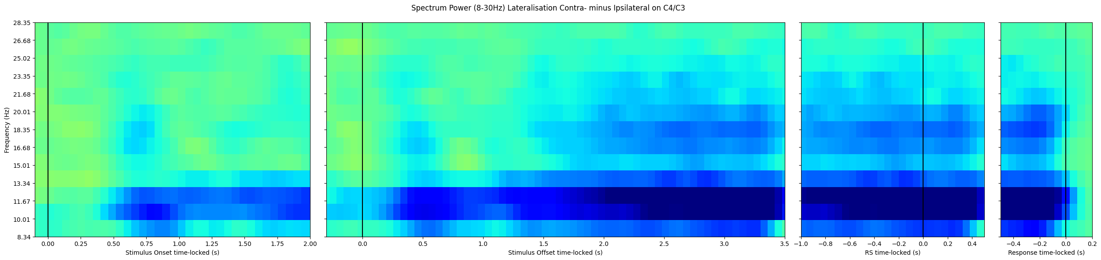
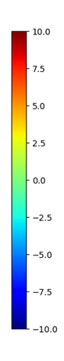
Time-Frequency Analysis (TFA)
STFT : choose an appropriate windows
Rogge et al. (2022) distinguished alpha (8-12Hz) and beta (13-30Hz) motor preparation signal.
To explore the alpha (8-12Hz) and beta (13-30Hz) in addition the classic mu-beta (8-30Hz), we choose a window of 600 ms to achieve a reasonable frequency resolution.
Spectrum Power Lateralization (8-30Hz), Contra- minus Ipsilateral on C4/C3
Beta
(13-30Hz)
Alpha
(8-12Hz)

Slide 21
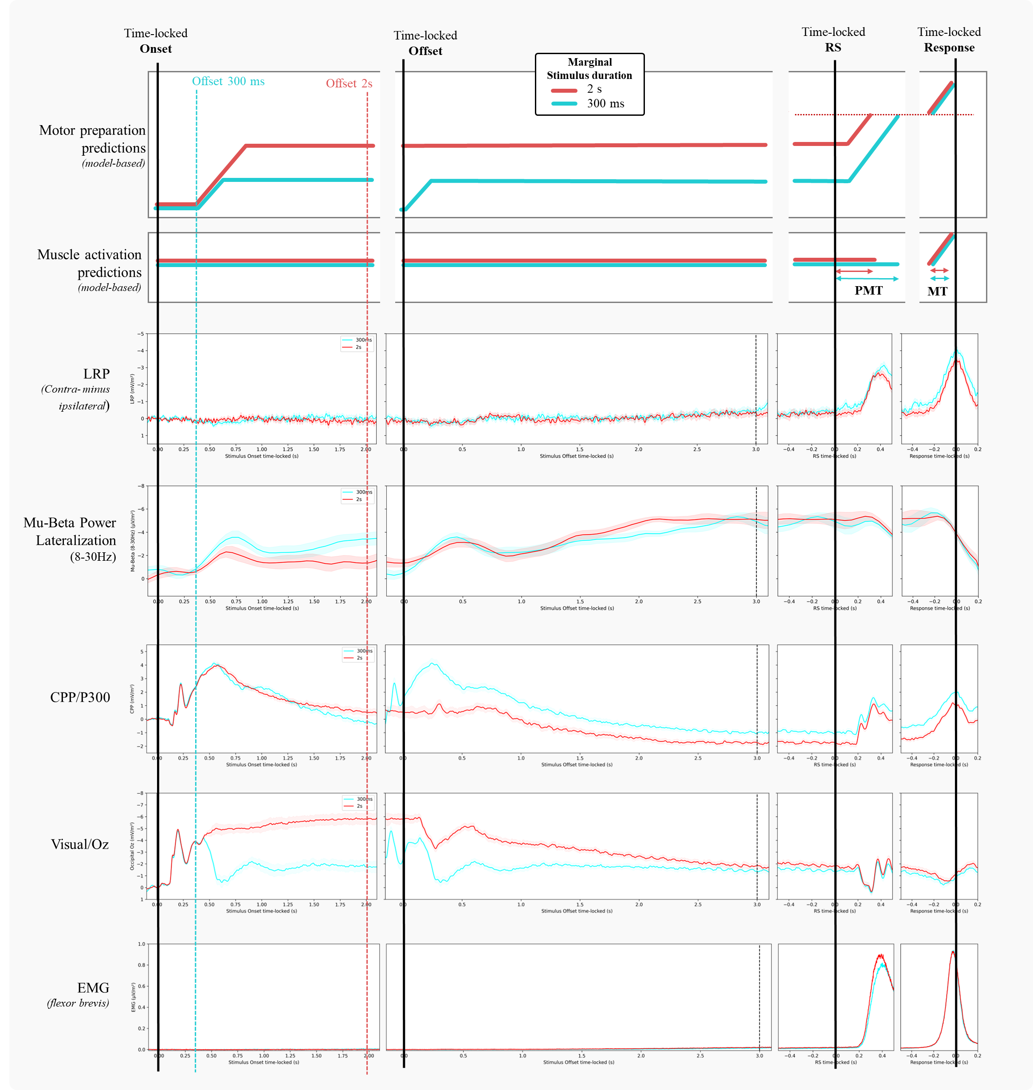
Model predictions for the effect of stimulus duration (averaged across motion coherence levels)
gate

Slide 22
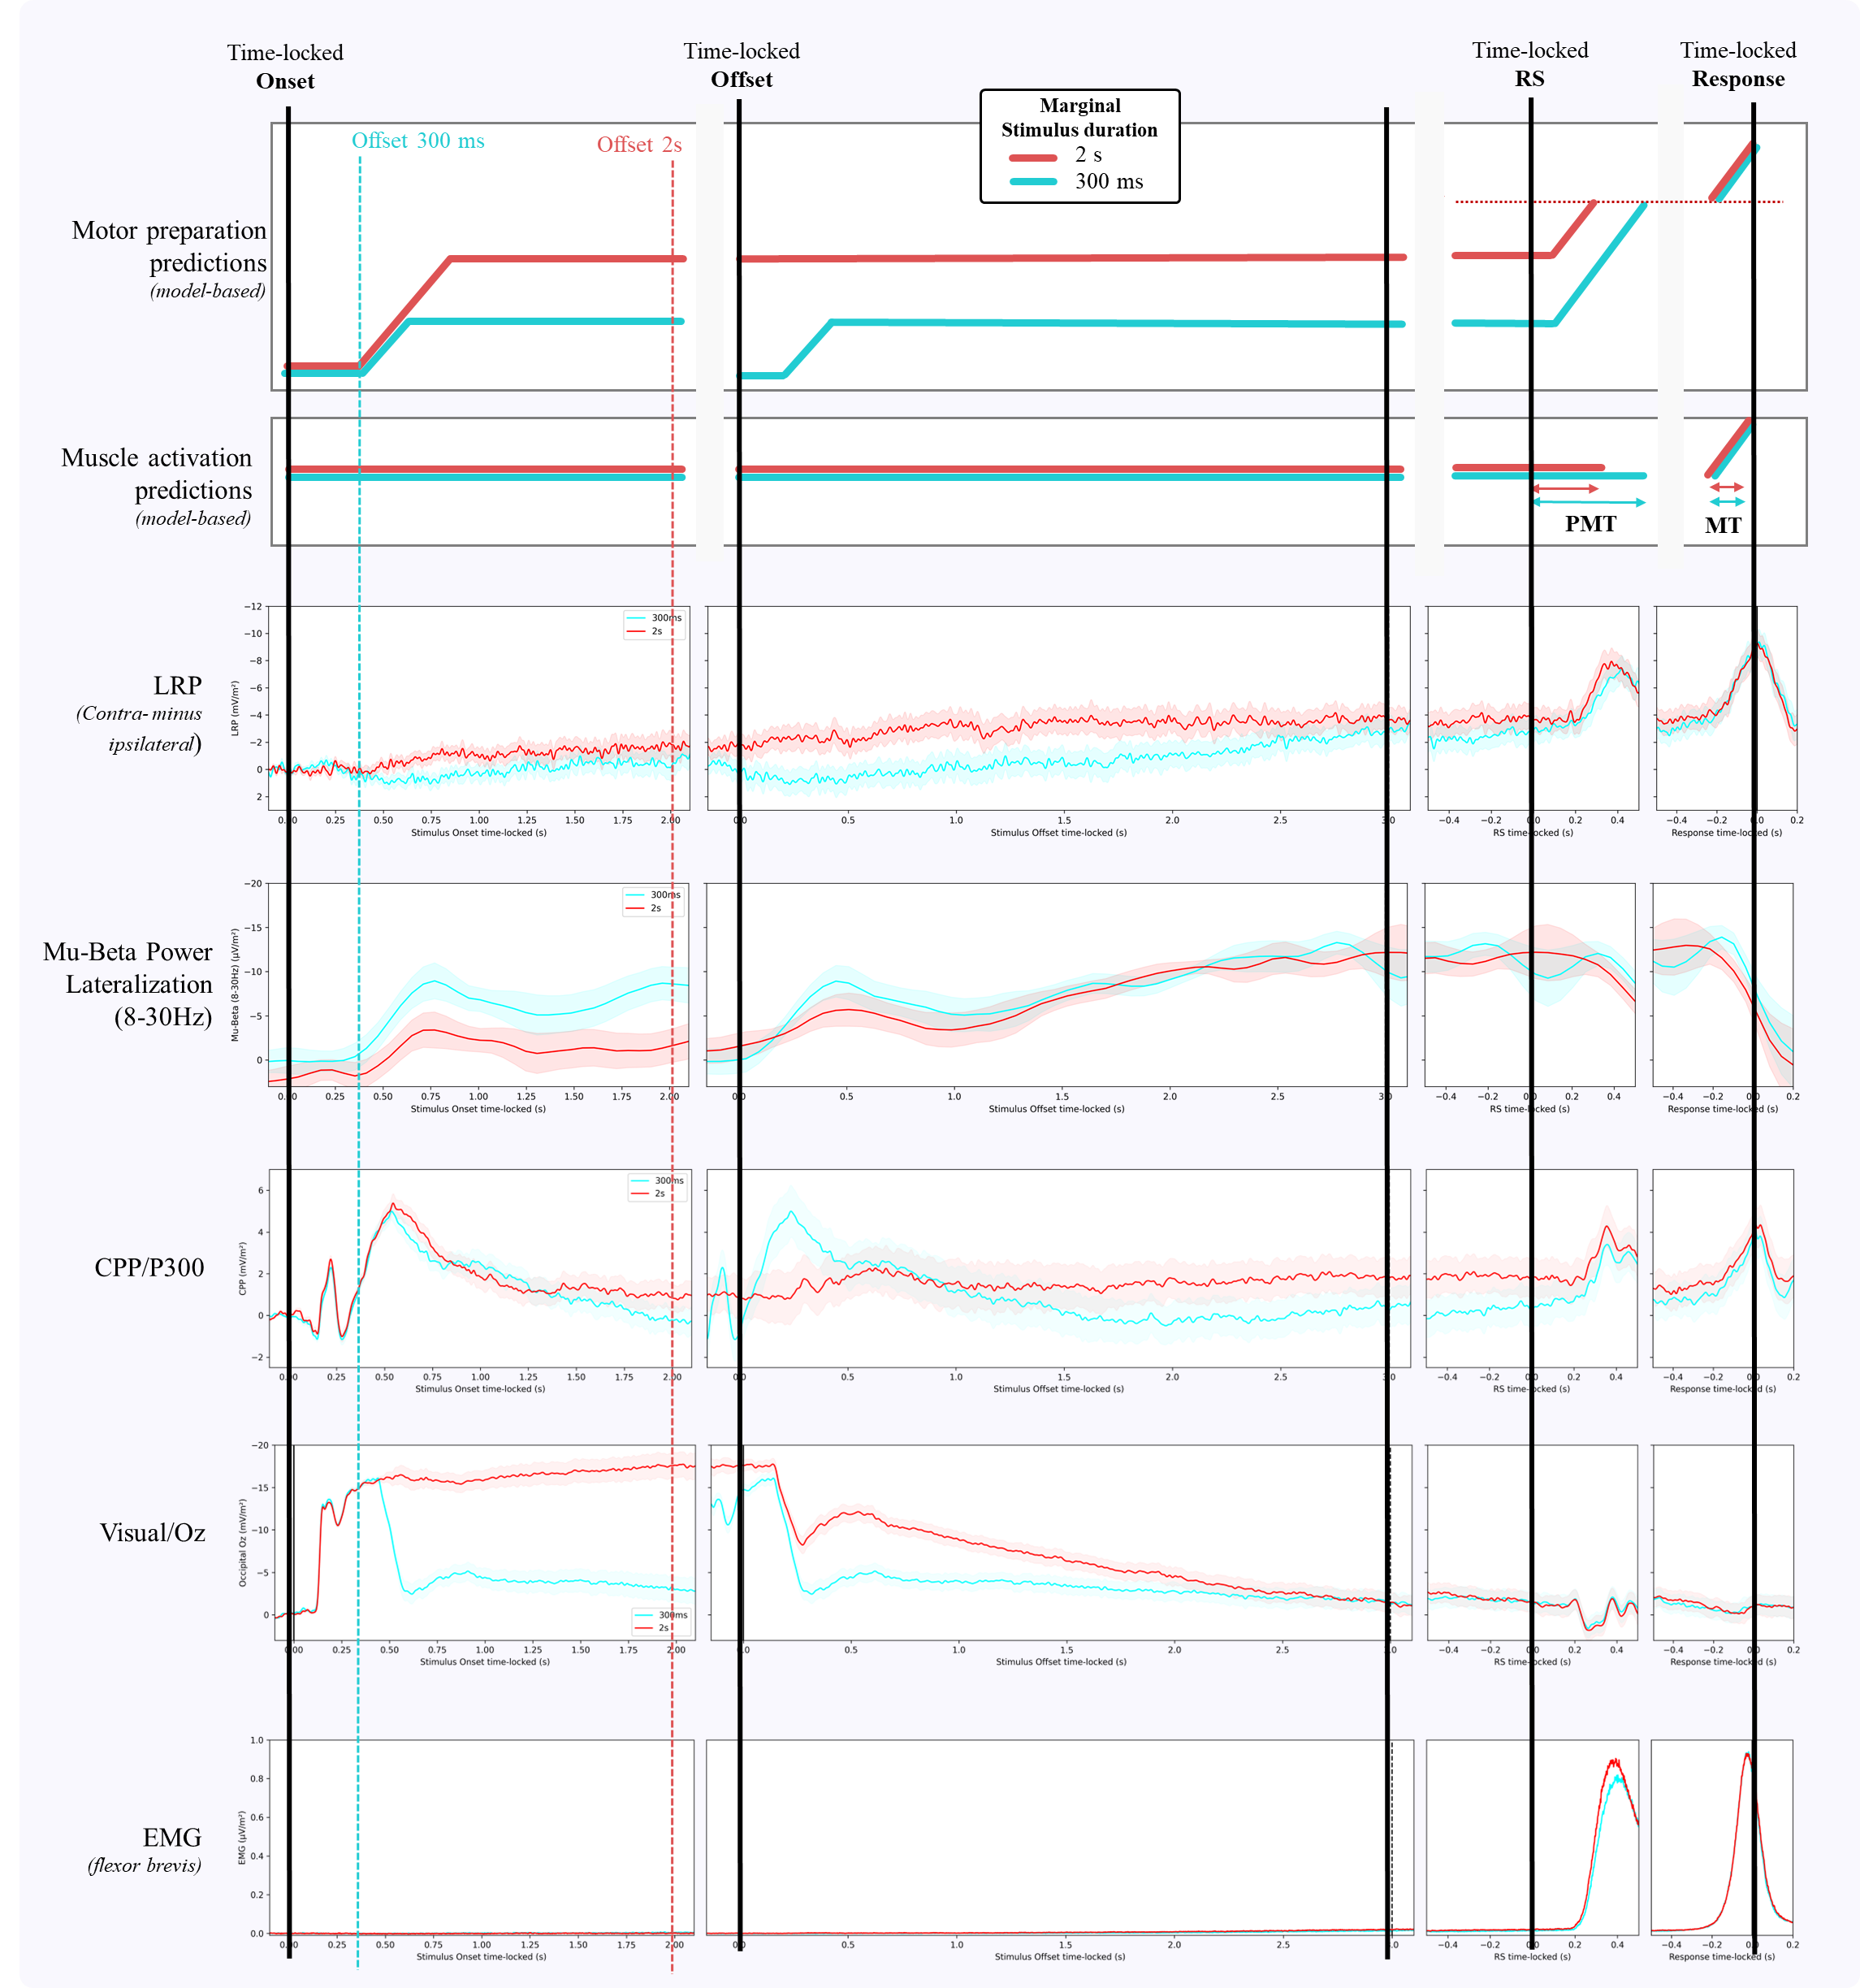
Stiffness = 4
Stiffness = 3
AU
AU

Slide 23
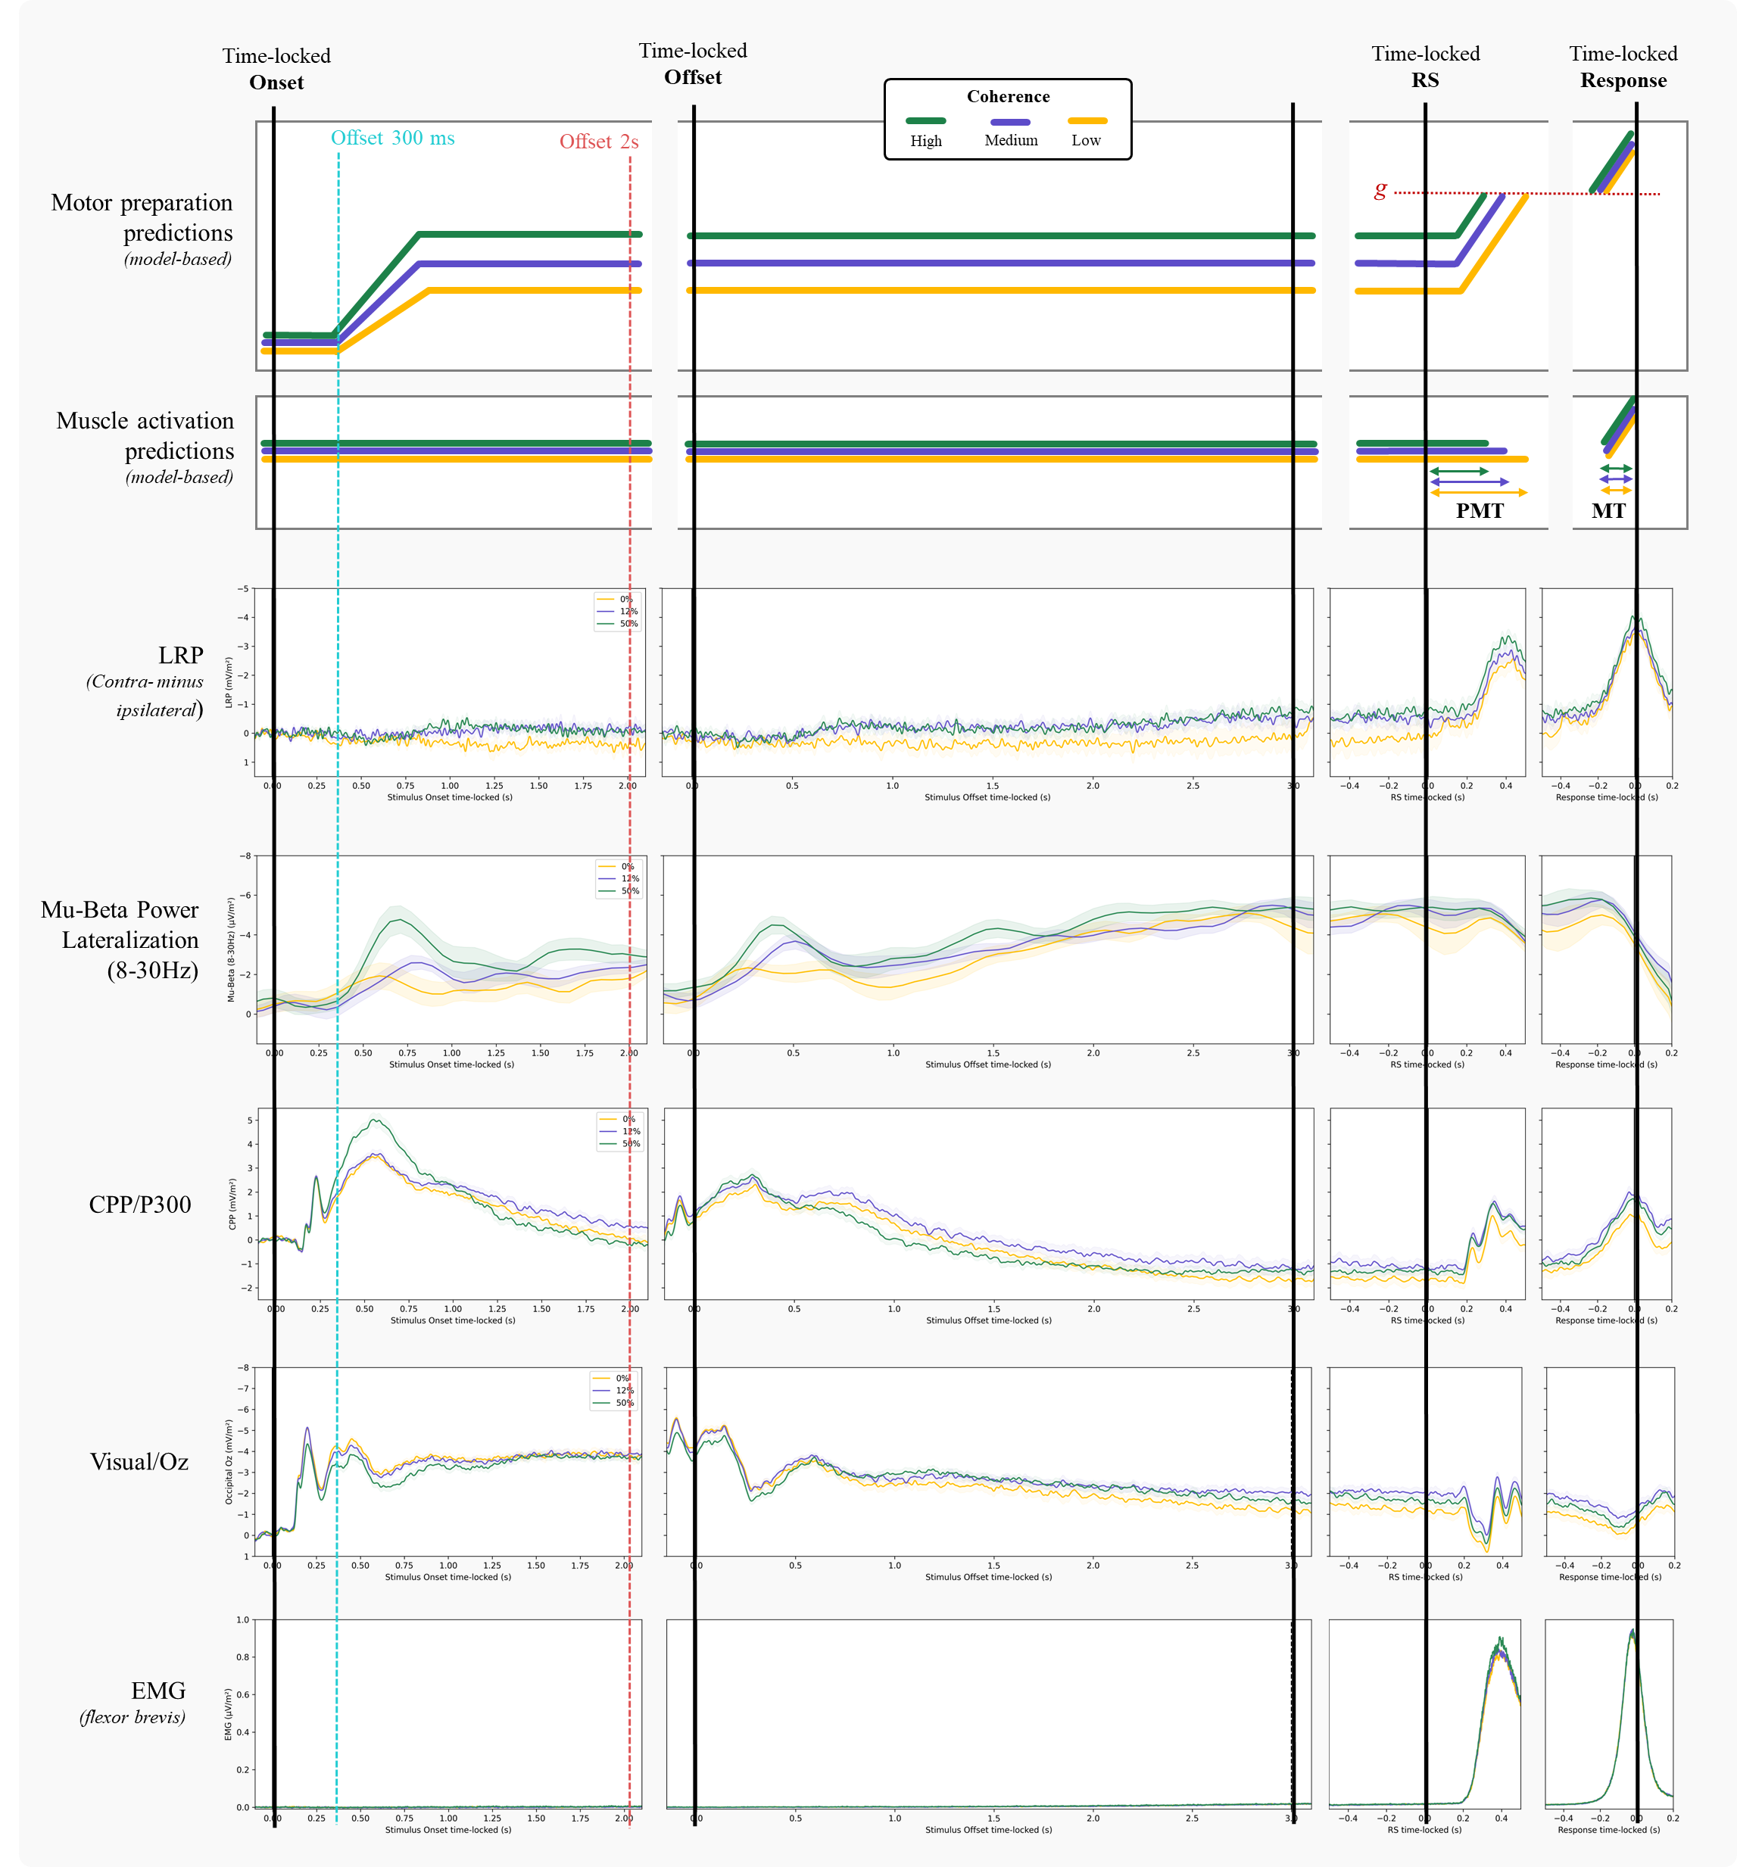
Model predictions for the effect of motion coherence (averaged across stimulus duration levels)

Slide 24
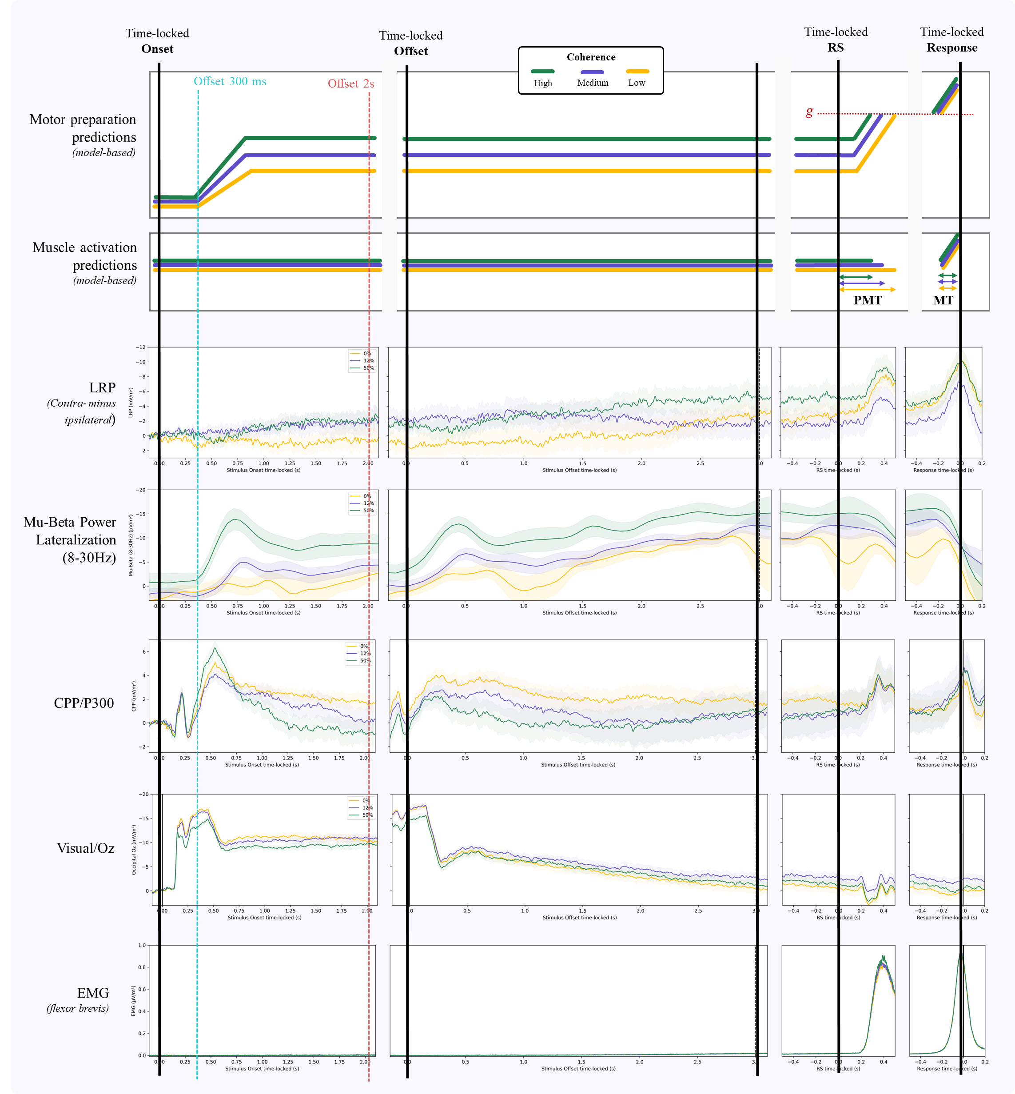
Stiffness = 4
Stiffness = 3
AU
AU

Slide 25
Perspectives
Write up the EMG/EEG work. The main issue concerns the stiffness parameter of the CSD. People have used both stiffness = 3 (e.g., Vidal, Burle) and 4 (e.g., O’Connell, Kelly) in the literature. Others have not used any CSD transform (e.g., Fromer, Rogge). Ours conclusions appear to be very different depending of these choices.
Third year of PhD: we are currently planning an experiment to investigate why the motion coherence effect of EMG slopes is sometimes reliable and sometimes not. Our hypothesis is that people store samples of evidence in memory and « replay » the decision after the response signal when the cost of doing so does not exceed the benefits (e.g., high reward for a correct response).

